Slide 1


Slide 2


Project Title
Pre-Final Year Project Synopsis
Submitted by
ROLL | NAME
2301010217 | Yash Karmakar
2301010239 | Nikhil Singh
2301010240 | Rucchika Kapoor
2301010243 | Avanish Thapliyal
2301010244 | Kamaljeet Hooda
Faculty Mentor: Dr. Ayyala Kishore Ajay Kumar
Notes:
New Courses replaced with New Programmes

Slide 3

Project Objectives
IoT Based system
Smart healthcare monitoring
Heart Rate, SpO₂, temprtatur, Faint detection
Cloud Dependent System
Secure Data Storage & Visulization
SOS Alert
Emergency Notification to the Doctor
Monitoring Health Parameters
Notes:
New Courses replaced with New Programmes

Slide 4
Specific Overview
Biomedical sensors with ESP32 for real-time vital monitoring
Provide scalable and low-cost healthcare monitoring solution
Design responsive web dashboard for doctors
Develop Android app for notifications and SOS
Transmit sensor data securely to cloud (Firebase)
Ethical handling, privacy, and access control of healthcare data
Notes:
New Courses replaced with New Programmes

Slide 5
Key Features
Real-time monitoring of vital signs
Cloud-based data storage and synchronization
Automatic emergency alerts (notifications/SMS)
Low-cost and scalable architecture
Role-based access (patient, caregiver, doctor)
Designed for elderly and chronic patients requiring continuous monitoring
Notes:
New Courses replaced with New Programmes

Slide 6
Project Usecases & Scope
Usecases :-
Home monitoring for elderly patients
Chronic disease management (SpO₂, heart conditions, BP Test, Faint Detect)
Post-hospital discharge monitoring
Rural and remote healthcare support
Scope :-
Multi-patient monitoring system Integration with additional sensors in future
Expansion to AI-based anomaly detection
Suitable for home care and community health centers
Notes:
New Courses replaced with New Programmes

Slide 7




Prototype/Project Flow diagram/Architecture
Hardware Lead
Embedded systems and sensor integration specialist
Alert
notifications
Wearable
sensor
Immediate alerts on threshold
Local filtering at node
Cloud Developer
Monitoring dashboard
Real-time Vital Data Flow
ESP32 microcontroller
Backend architecture and real-time database expert
Live visualization
Collects and preprocesses
Firebase Realtime DB
Wi-Fi
transmission
Data and ML
Secure, periodic pushes
Algorithm development and baseline modeling specialist
Low-latency storage
Notes:
New Courses replaced with New Programmes

Slide 8
Data & Resources
Data
Patient profile data
Real-time vital signs
Historical health records
Alert logs
Resources
ESP32 development board
MAX30102 pulse
Oximeter and Motion sensor
Temperature sensor (DS18B20/LM35)
Firebase Realtime Database
Firebase Authentication
Web & Android development tools
Notes:
New Courses replaced with New Programmes

Slide 9
Methodology
Encryption in Transit
Feature | Others | Ours
Monitoring | Spot checks | Continuous 24/7
Alerts | Fixed thresholds | Personalized deviation
Cost | 3k-5k | Prototype 2K
Eco-system | Closed proprietary | Open and Scalable
All data transmission uses HTTPS encryption to prevent interception and ensure secure communication between devices and cloud infrastructure
Secure Authentication
Multi-factor authentication and role-based access control ensure only authorized users can view patient data
User Consent
Explicit opt-in consent required for all data collection, with transparent disclosure of how information is used
Notes:
New Courses replaced with New Programmes

Slide 10
Expected Results & Impact
Expected Results
    Accurate real-time monitoring of vital signs
    Reliable alert generation during emergencies
    Easy access to patient health data remotely
Impact
    Reduced medical emergencies through early detection
    Improved quality of life for elderly and chronic patients
    Reduced burden on hospitals and caregivers
    Affordable and scalable healthcare solution ￼
Notes:
New Courses replaced with New Programmes

Slide 11
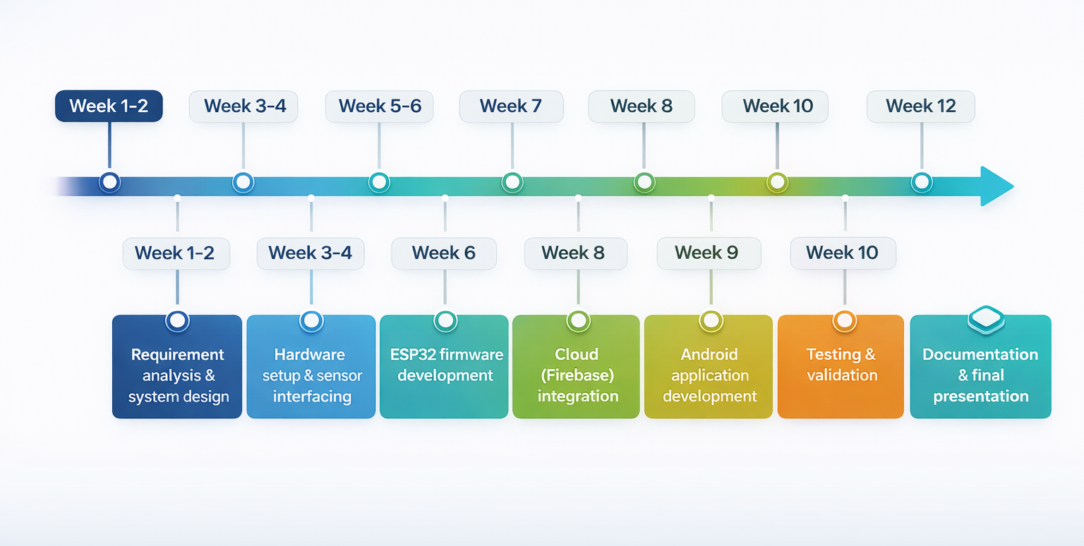
Project Timeline
Notes:
New Courses replaced with New Programmes

Slide 12
THANK YOU

